Slide 1



Geonobles I Cycling Data Analysis Group members: Katariina, Sonja, Seppo, Sönke

Slide 2
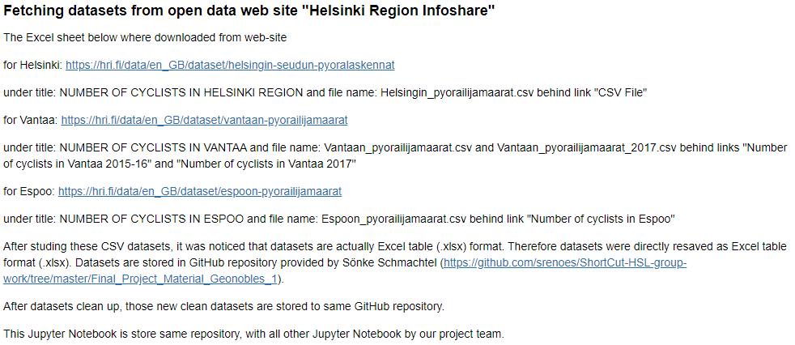
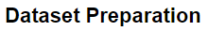
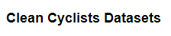
Cyclists in Helsinki, Vantaa and Espoo
Katariina

Slide 3
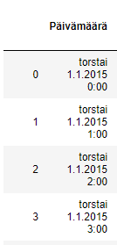
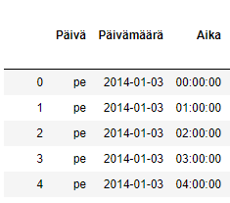
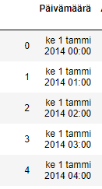
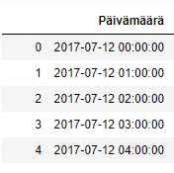
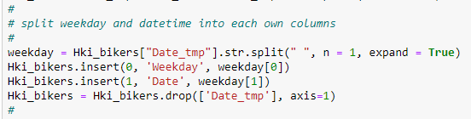
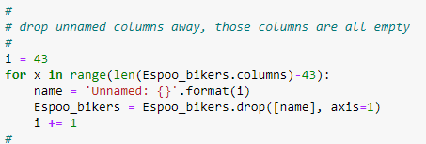
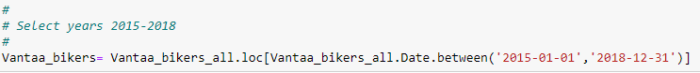
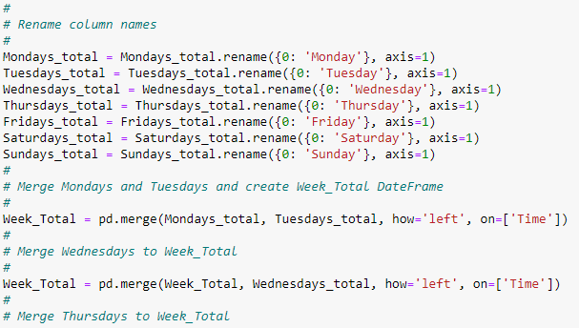
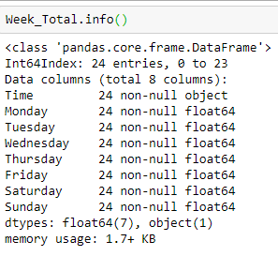
Cyclists in Helsinki, Vantaa and Espoo
Katariina
Combine all measurement
points together (sum of them)

Slide 4
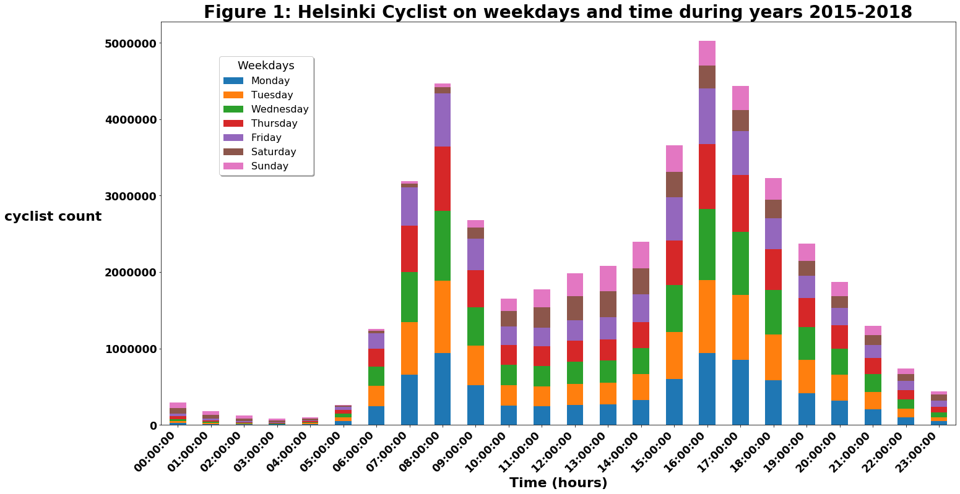
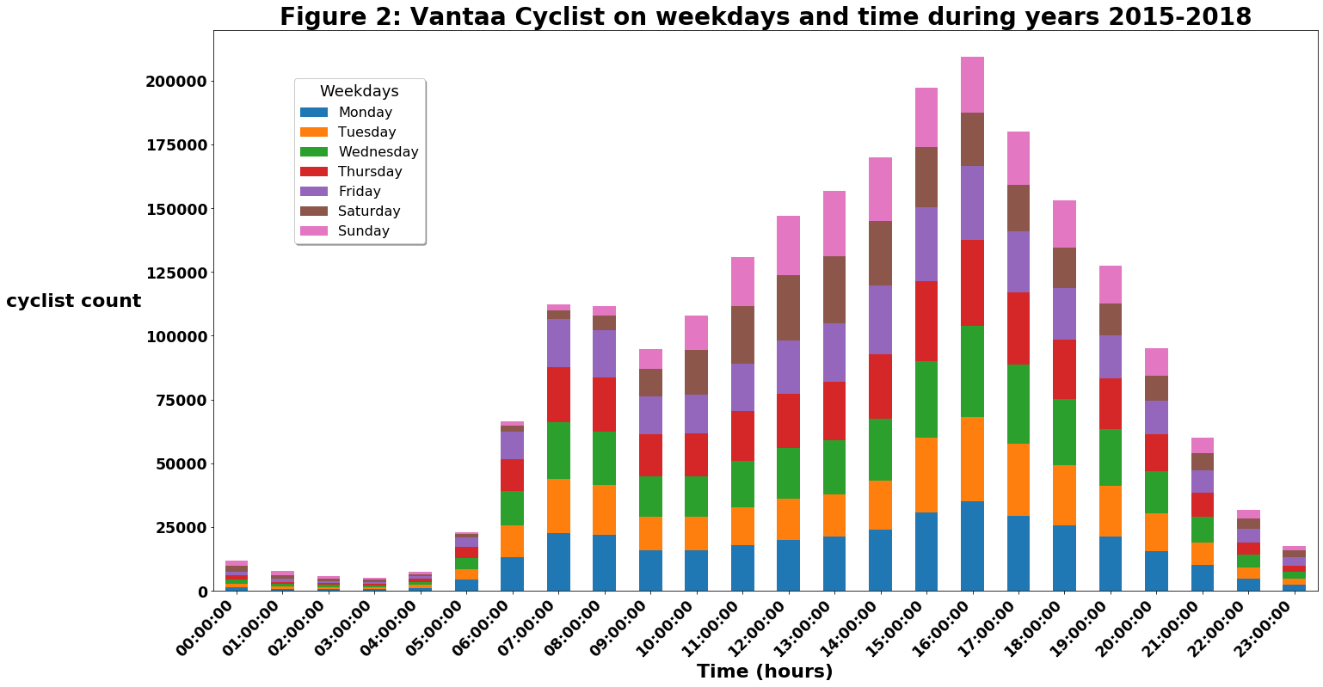
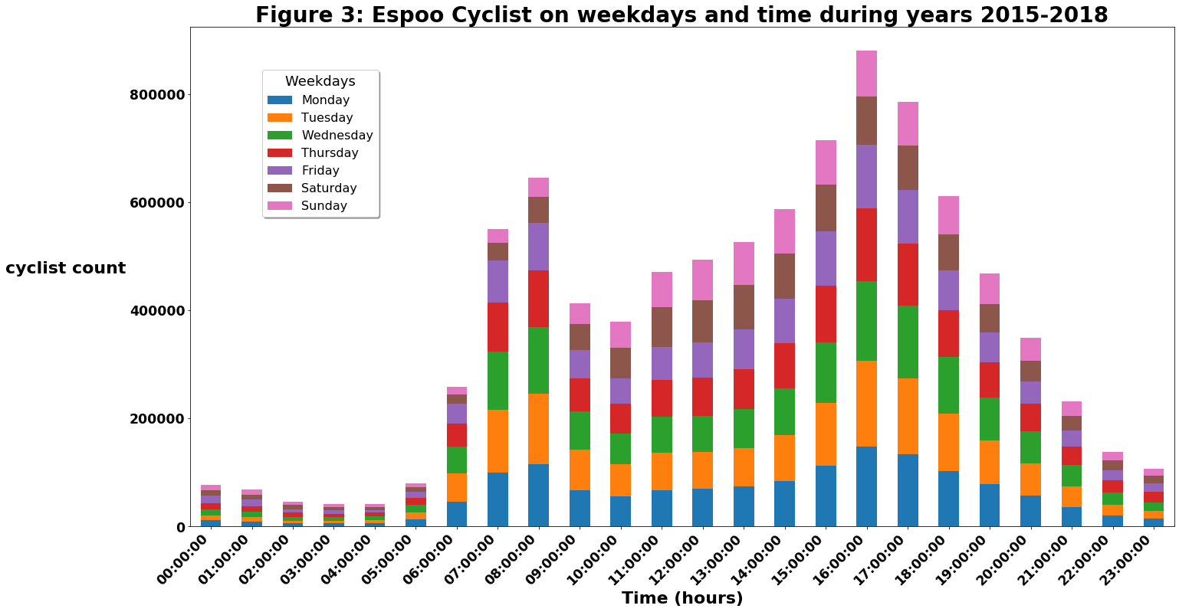
Cyclists in Helsinki, Vantaa and Espoo
Katariina
Visualization
There are clear spikes in cycling numbers during the morning and afternoon rush hour in Helsinki and Espoo.
However it is different situation Vantaa cycling pattern is during weekdays. It seems in Vantaa bikes are used more evenly during a day then in Helsinki and Espoo.

Slide 5
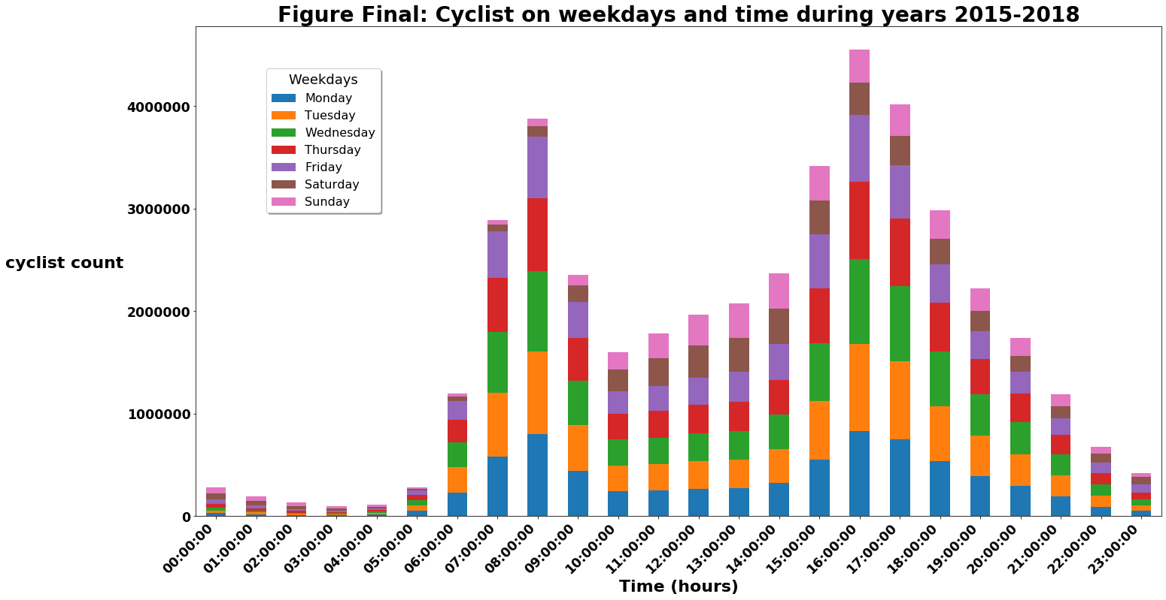
Cyclists in Helsinki, Vantaa and Espoo
Katariina
Final Analysis
Even when all three cities cyclists number is added together their are very clear pattern emerged during rush hours. Based on this people clearly uses bikes to commute between home and work.

Slide 6
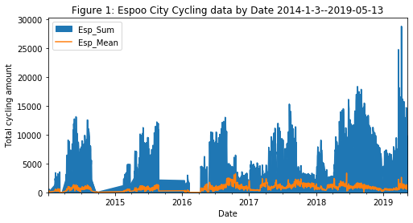
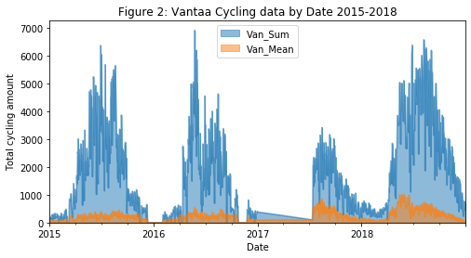
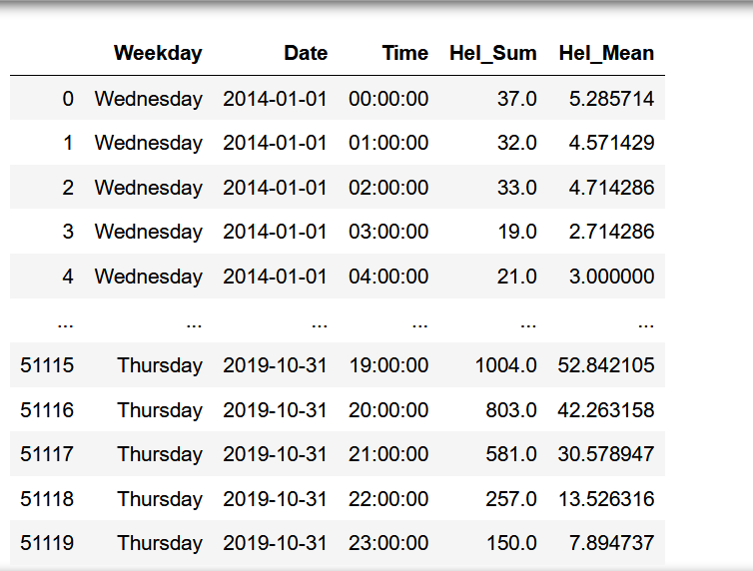
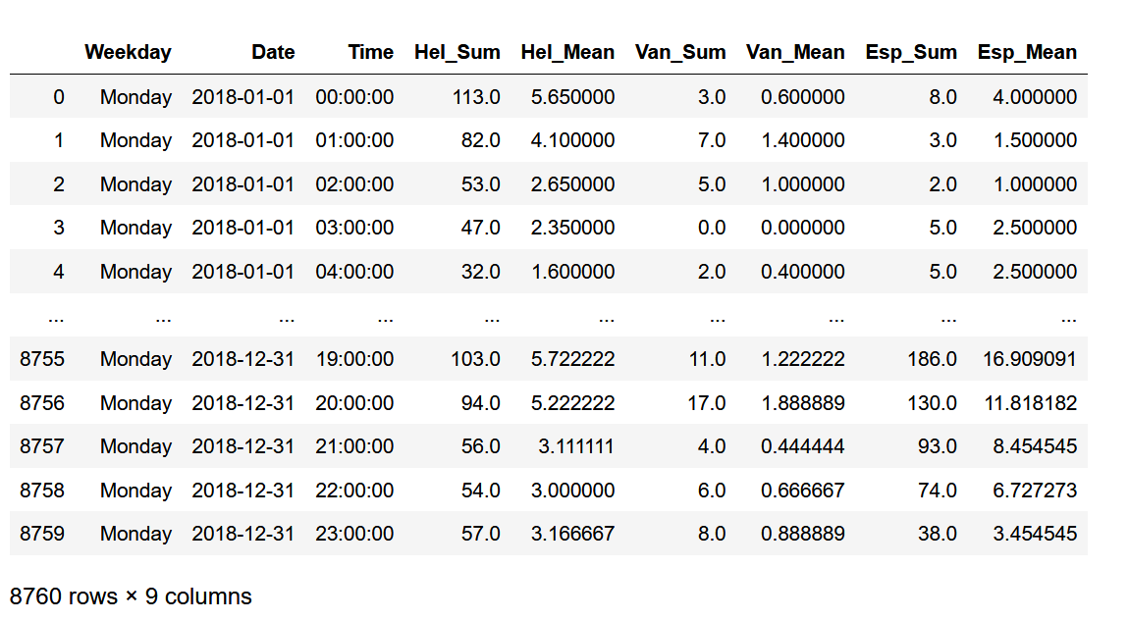
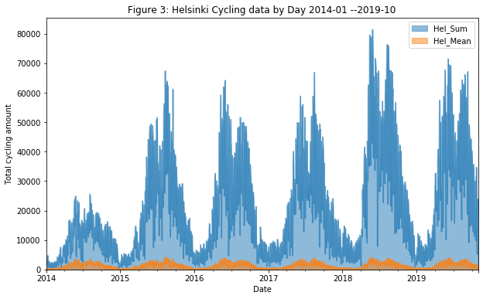
Datasets checking ● DataFrame for grouping and visualizing
Wed,2014-01-01,00:00:00,,7.0,,1.0,,,,,,,,2.0,5.0,3.0,,11.0,,,,8
Wed,2014-01-01,01:00:00,,5.0,,3.0,,,,,,,,6.0,5.0,1.0,,8.0,,,,4
Fri,2014-09-26,00:00:00,,,,,,,,,,,,,,,1.0,,,,,,,,,,,,,,,,,,,,,,,,,
Fri,2014-09-26,01:00:00,,,,,,,,,,,,,,,0.0,,,,,,,,,,,,,,,,,,,,,,,,,
Fri,2014-09-26,02:00:00,,,,,,,,,,,,,,,0.0,,,,,,,,,,,,,,,,,,,,,,,,,
Wed,2016-02-10,00:00:00,,,,,,,,,,,,,,,,,,,,,,,,,,,,,,,,,,,,,,,,
Wed,2016-02-10,01:00:00,,,,,,,,,,,,,,,,,,,,,,,,,,,,,,,,,,,,,,,,
Sonja
The input dataset can have:
1.Missing rows
2.Rows with missing numeric data only
3.Rows with 0.0 values and missing numeric data only
4.Rows with data and missing numeric values
Mean=NaN
apps_esp_sm.count()
Weekday 38016
Date 38016
Time 38016
Esp_Sum 38016
Esp_Mean 35782
dtype: int64
apps_hel_sm.count()
Weekday 51120
Date 51120
Time 51120
Hel_Sum 51120
Hel_Mean 51120
dtype: int64

Slide 7
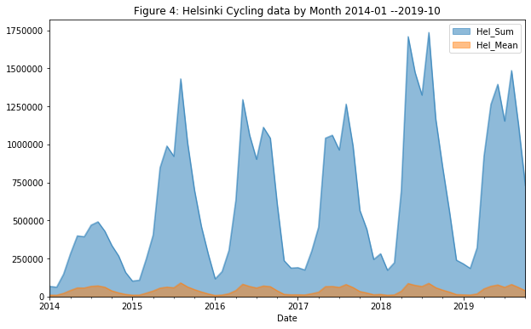
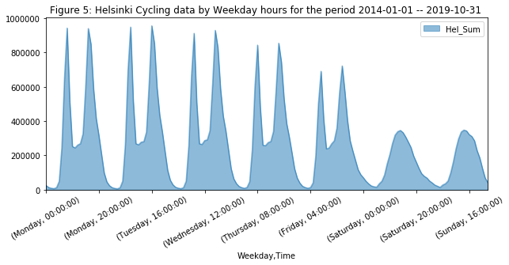
Helsinki Cycling data ‘groupby’ Year, Month, Weekdays, Hours This analysis is based on data we have from automated bicycle counters with full year of validated data in 2014 - 2018. Total bicycle counts have been summed-up for each hour of the day, then summed-up to the month. Conclusion: The most cycled month of Helsinki through 2014 – 2018 is August of 2018.
Sonja
Indicator | 2014 | 2015 | 2016 | 2017 | 2018
Most cycled month | 2014-08 | 2015-08 | 2016-05 | 2017-08 | 2018-08
2nd Most cycled month | 2014-07 | 2015-09 | 2016-08 | 2017-06 | 2018-05
3rd Most cycled month | 2014-09 | 2015-06 | 2016-06 | 2017-05 | 2018-06
Least cycled month | 2014-02 | 2015-01 | 2016-01 | 2017-02 | 2018-02
Least cycled month | 2014-01 | 2015-02 | 2016-02 | 2017-01 | 2018-03
Least cycled month | 2014-03 | 2015-03 | 2016-12 | 2017-12 | 2018-12
Helsinki Most Cycled Hour on Weekday is
Tuesday 16:00:00
Indicator | Monday | Tuesday | Wed. | Thursday | Friday | Saturday | Sunday
Most cycled hour | 08:00:00 | 16:00:00 | 16:00:00 | 16:00:00 | 16:00:00 | 14:00:00 | 14:00:00
2nd Most cycled hour | 16:00:00 | 08:00:00 | 08:00:00 | 08:00:00 | 08:00:00 | 13:00:00 | 15:00:00
3nd Most cycled hour | 17:00:00 | 17:00:00 | 17:00:00 | 17:00:00 | 17:00:00 | 15:00:00 | 13:00:00
Least cycled hour | 03:00:00 | 03:00:00 | 03:00:00 | 03:00:00 | 03:00:00 | 05:00:00 | 05:00:00
2nd Least cycled hour | 02:00:00 | 02:00:00 | 02:00:00 | 02:0 0:00 | 04:00:00 | 04:00:00 | 04:00:00
3rd Least cycled hour | 04:00:00 | 04:00:00 | 04:00:00 | 04:00:00 | 02:00:00 | 03:00:00 | 03:00:00

Slide 8
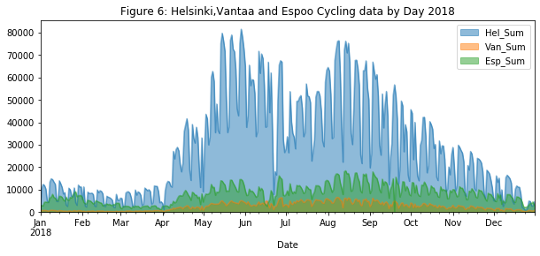
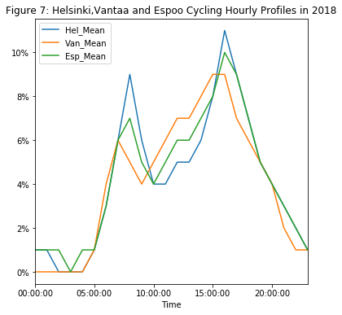

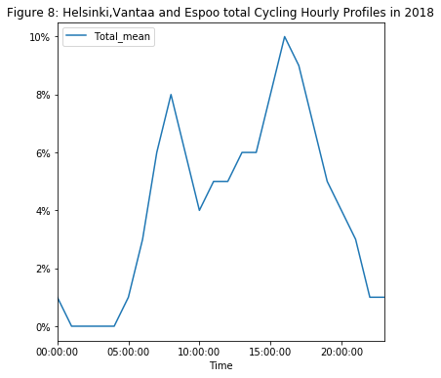
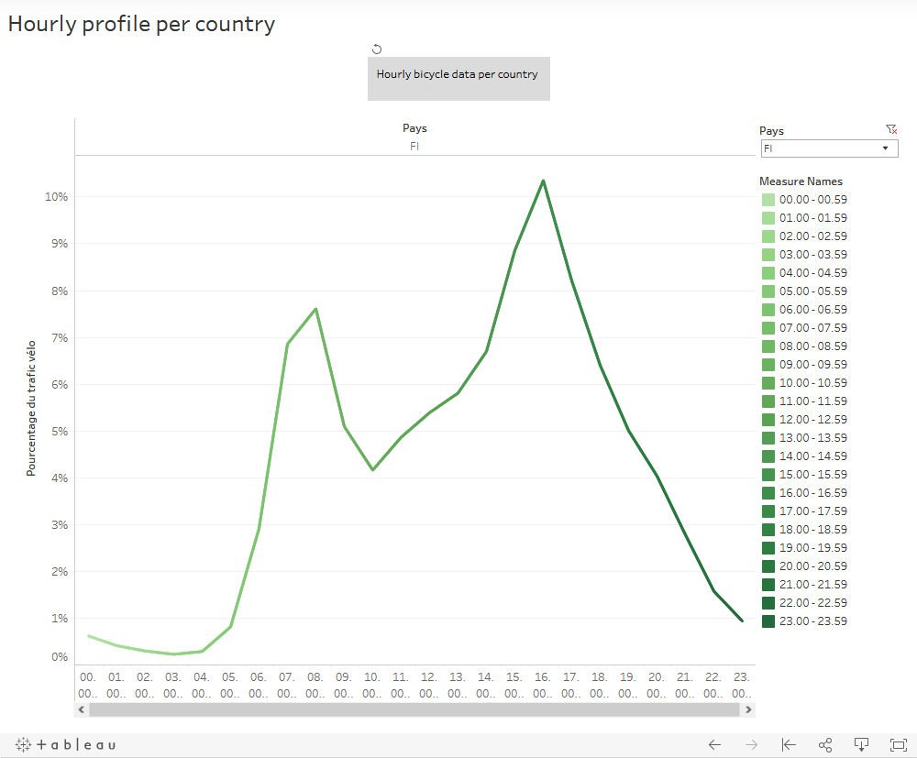
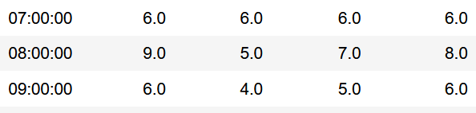
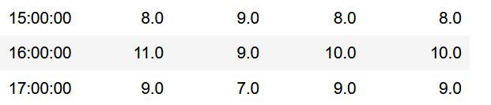
Helsinki, Vantaa and Espoo Cycling data and Hourly Profiles in 2018 This analysis is based on data we have from automated bicycle counters with a full year of validated data in 2018. Total bicycle counts have been summed-up for each day of the year of each city. The percentage of cycling Hourly Profile is calculated by comparing the average number of cyclists of each hour with the average daily traffic for every city.
Sonja
Indicator | Helsinki | Vantaa | Espoo
Most cycled days | 2018-05-29 | 2018-08-08 | 2018-08-14
2nd Most | 2018-05-15 | 2018-06-28 | 2018-08-13
3rd Most | 2018-05-22 | 2018-08-07 | 2018-09-03
Least cycled days | 2018-12-25 | 2018-04-02 | 2018-09-19
2nd Least | 2018-12-24 | 2018-01-01 | 2018-03-31
3rd Least | 2018-04-02 | 2018-02-24 | 2018-03-30
Most cycled days of the year in 2018 in Total
2018-05-29: Total: 101110
VS.
Reference Link:
https://www.eco-compteur.com/en/2019-worldwide-cycling-index/

Slide 9

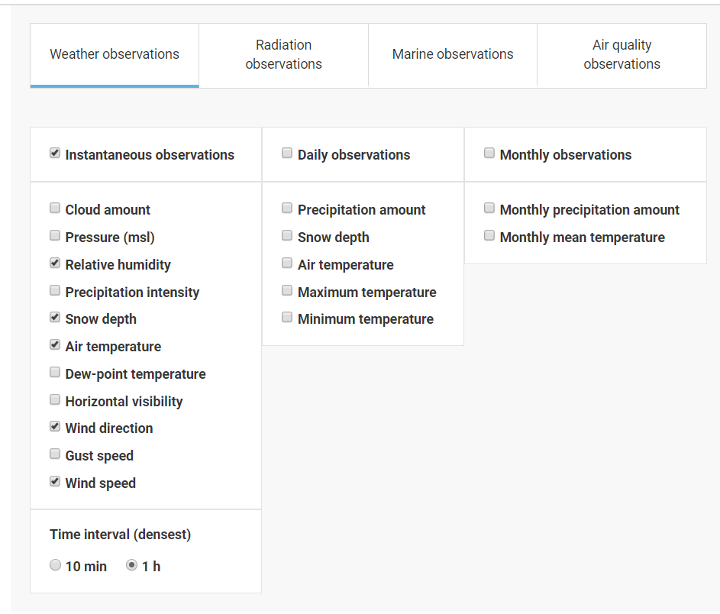

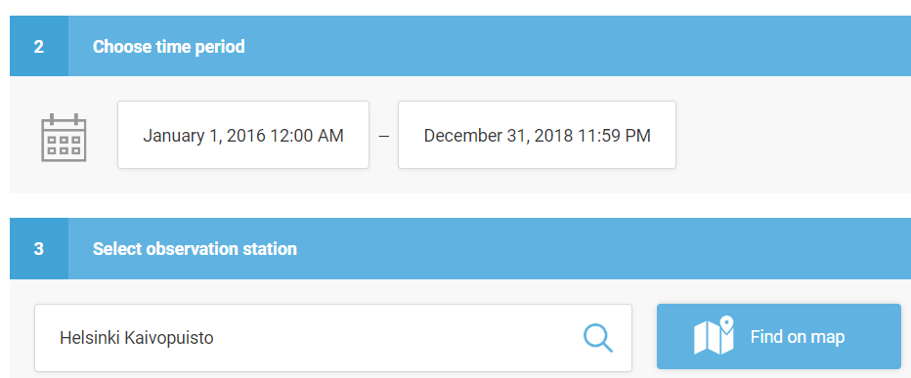
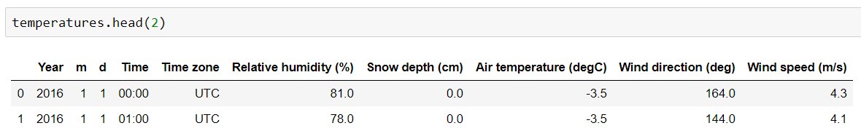
Combining two datasets: Cyclists and Weather
Seppo

Slide 10
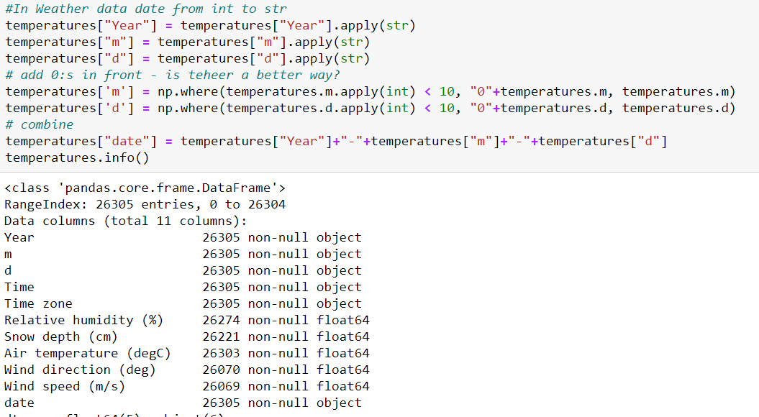
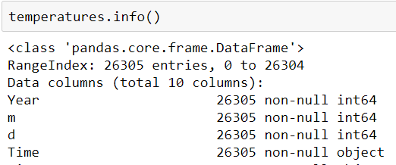
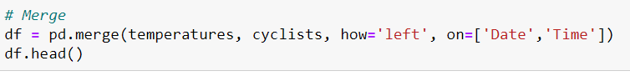
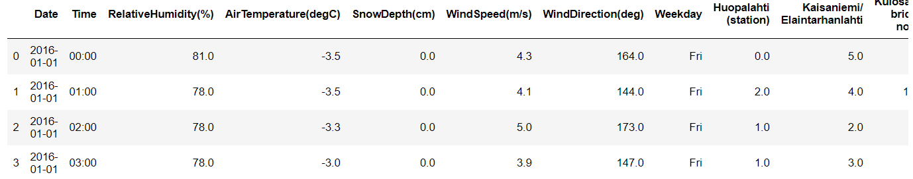
Merge the datasets by date and hour
Seppo

Slide 11
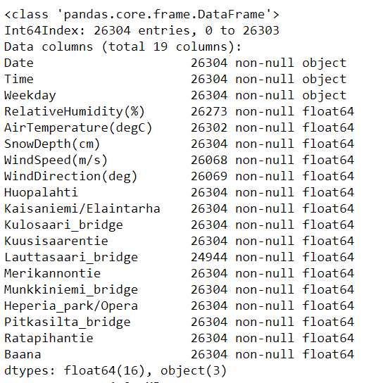
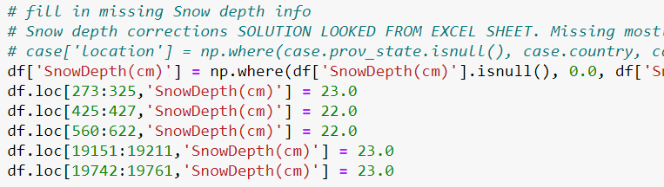
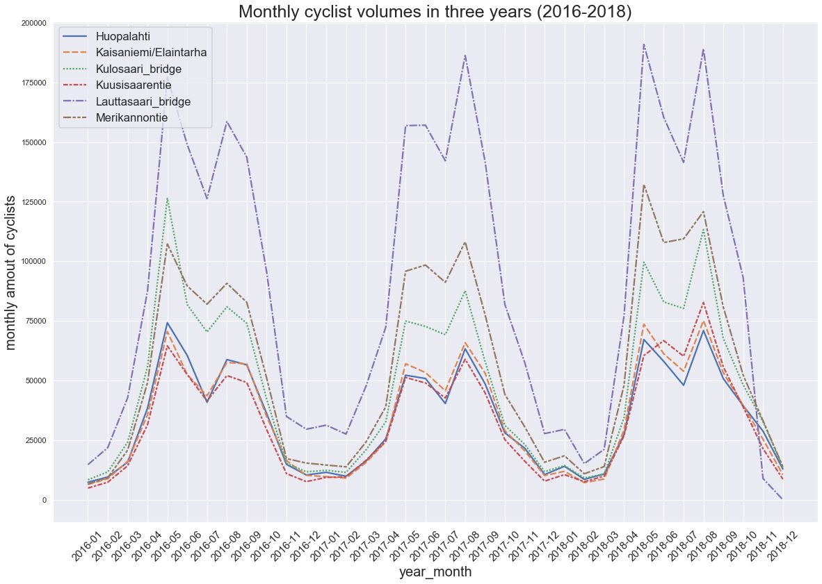
Cleaning dataset
Seppo

Slide 12
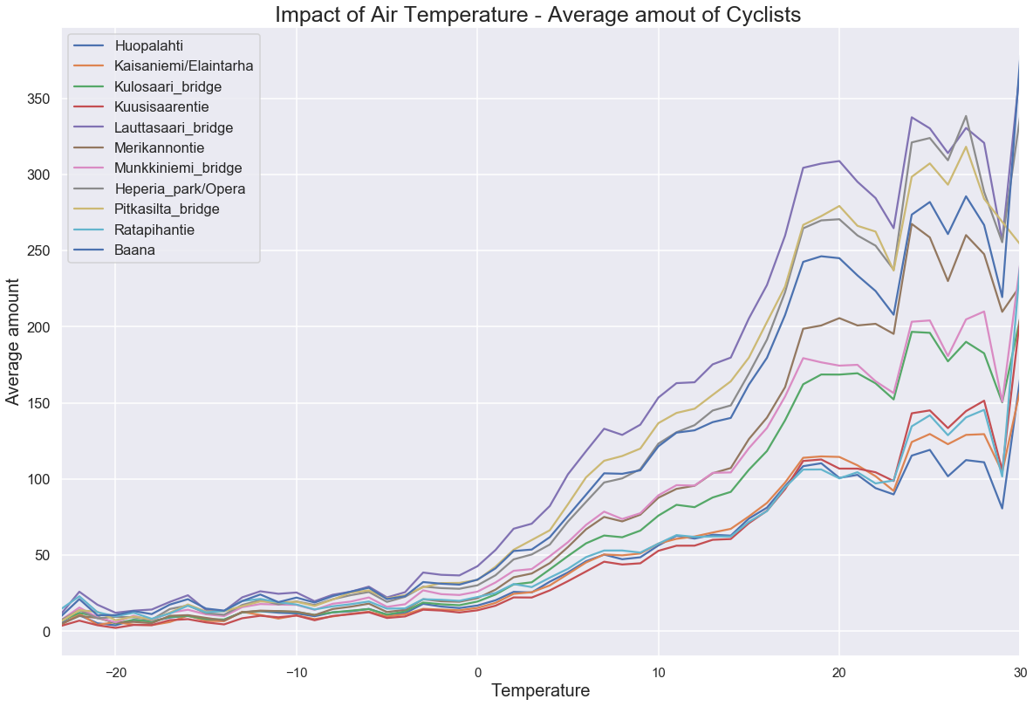
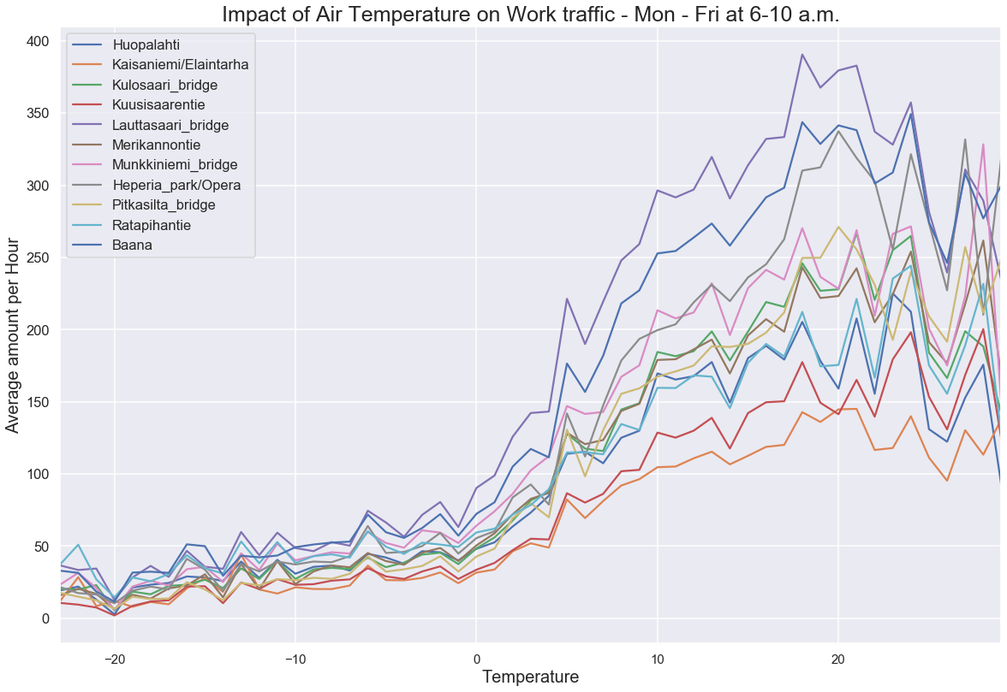
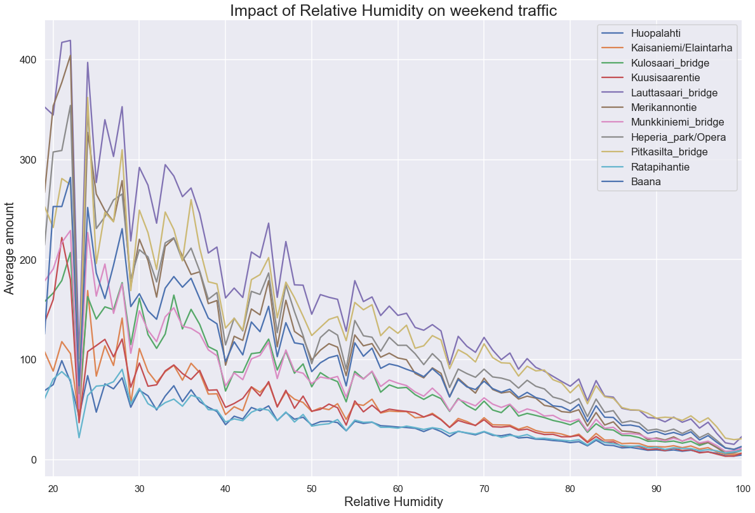
Example analysis
Seppo
All the stations have a similar pattern. Biggest noise
seems to be due some very small measurement
amounts for some temperatures.

Slide 13
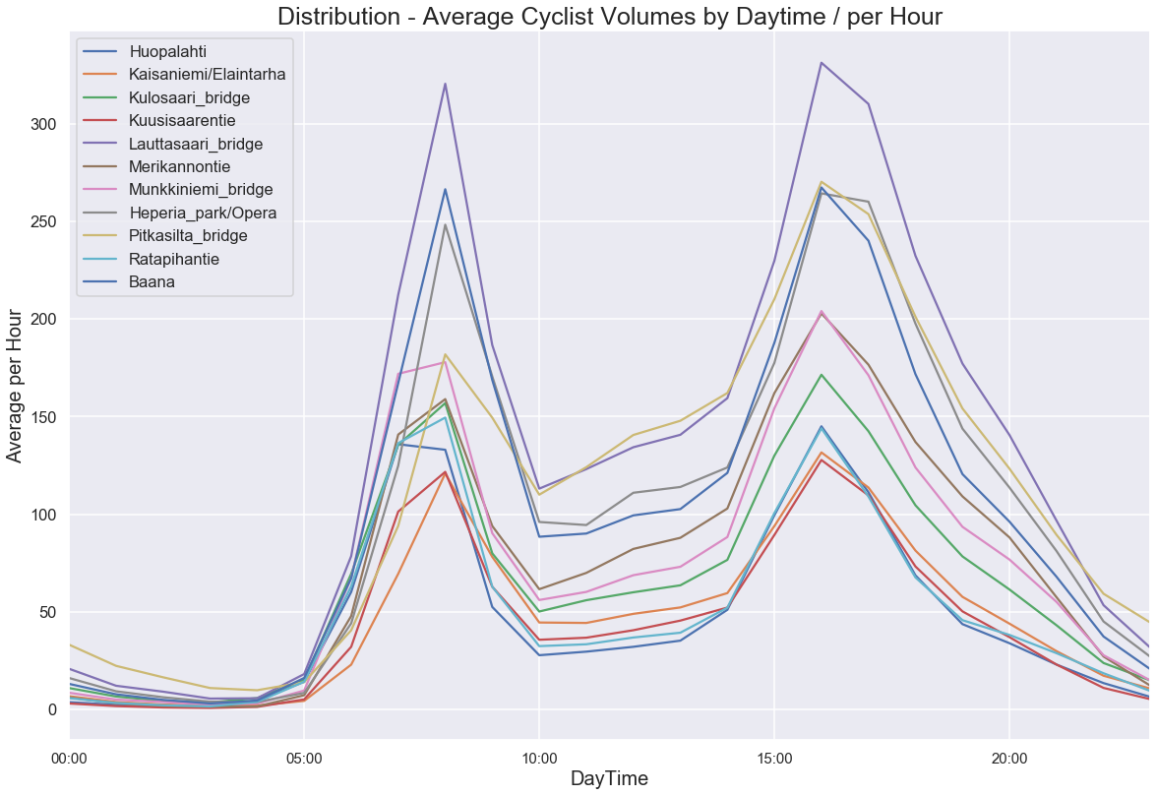
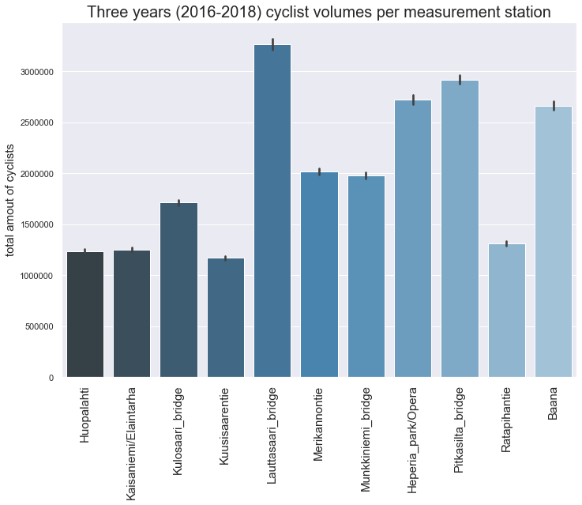
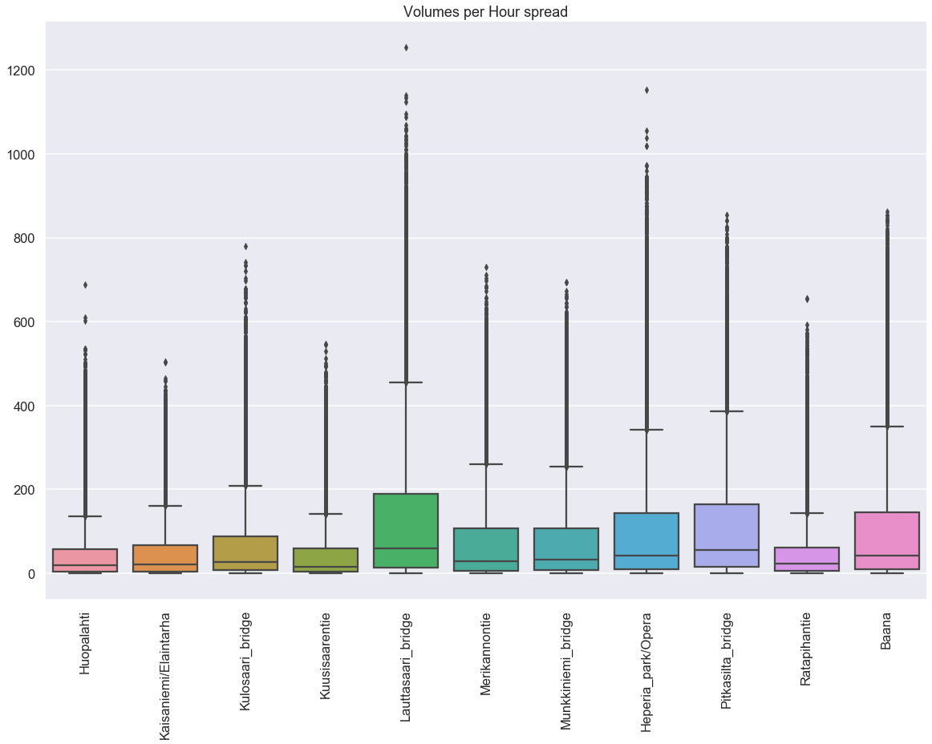
Additional slide
Seppo

Slide 14
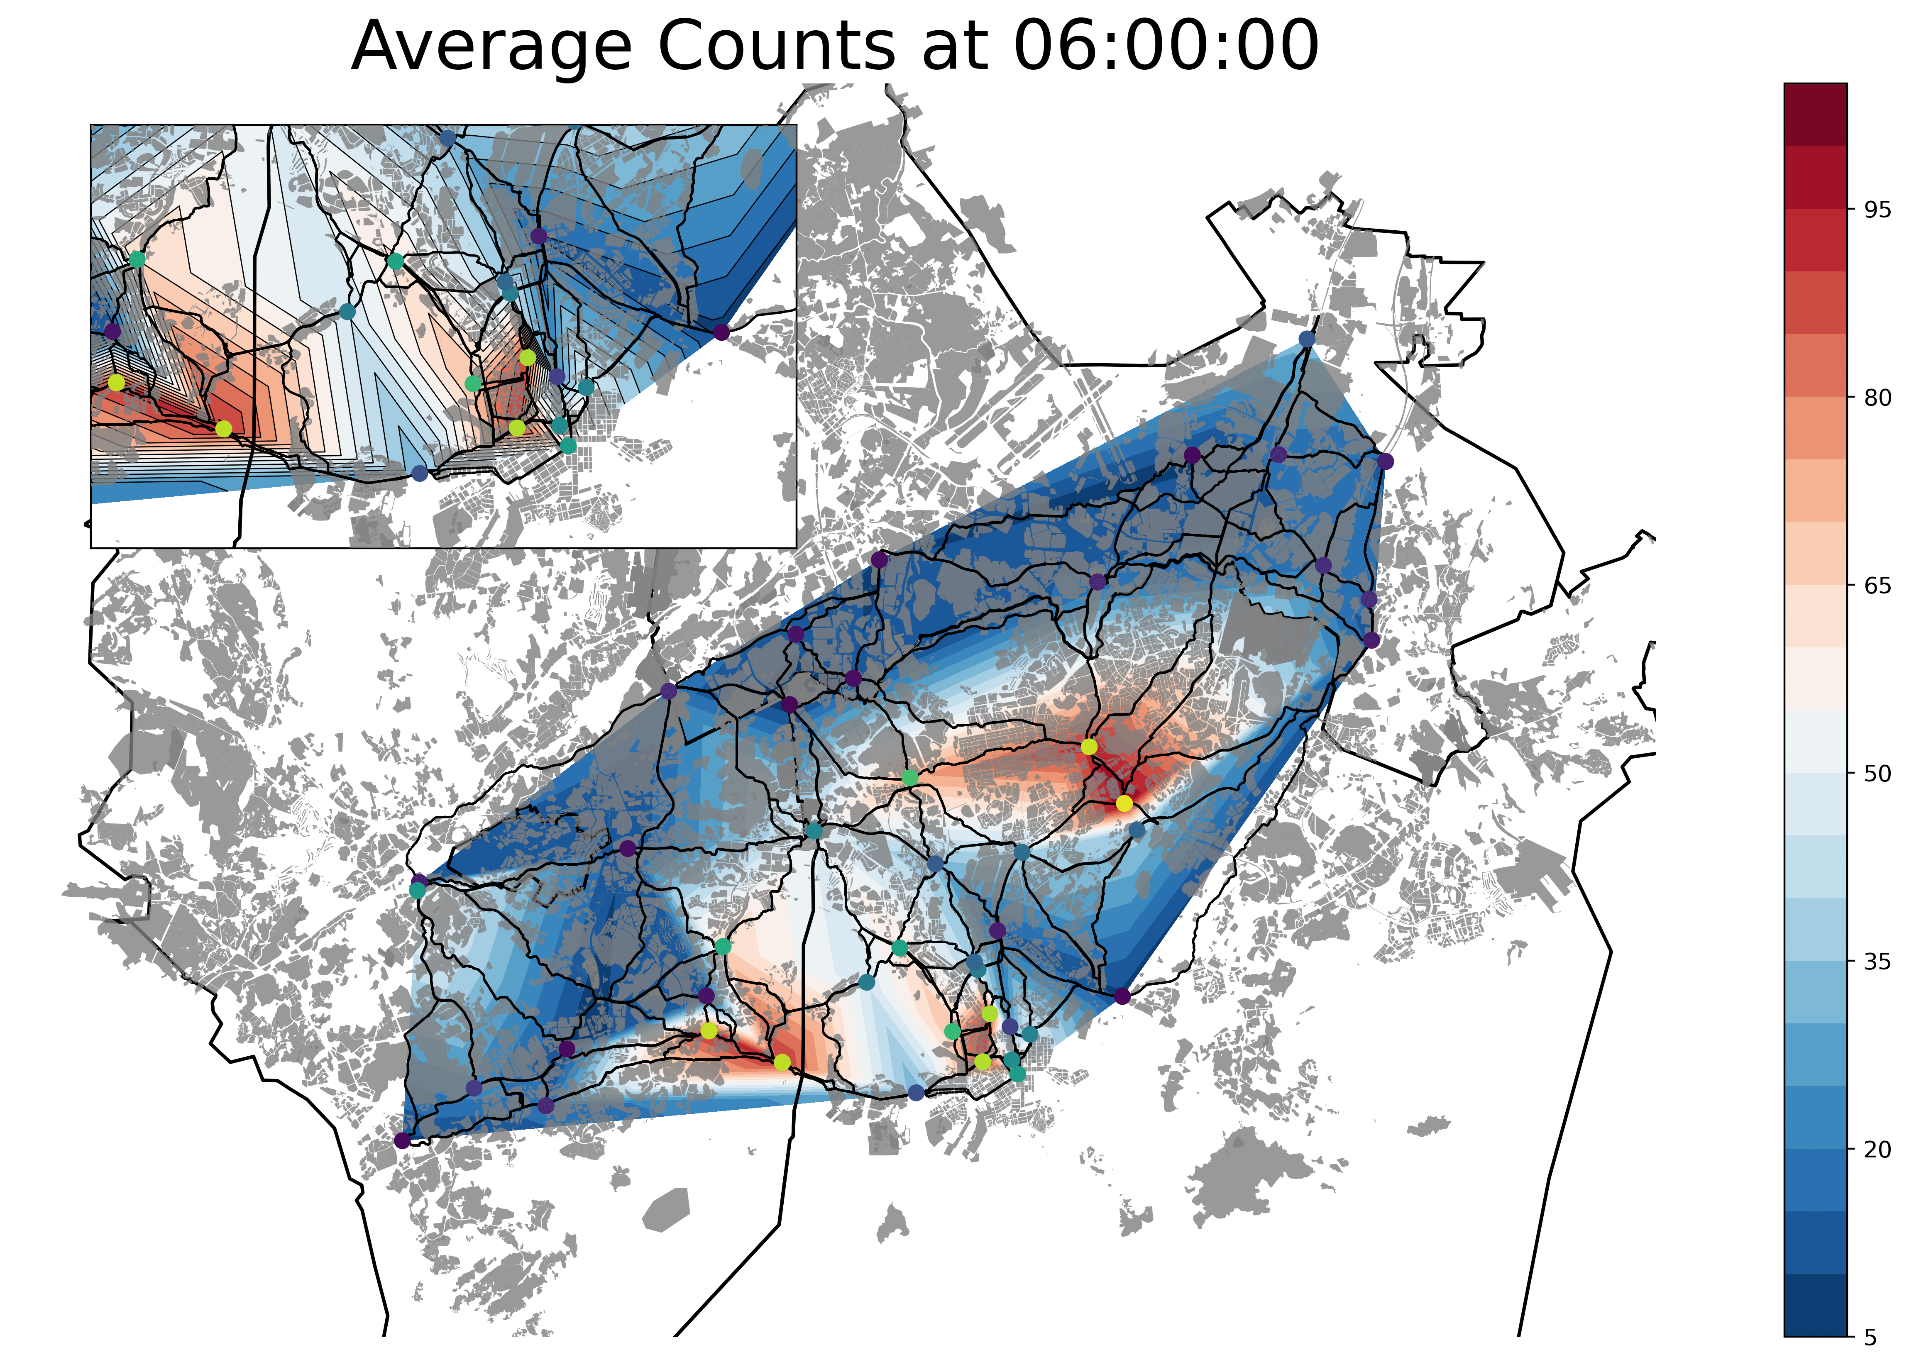
Displaying Traffic data on a map
Sönke

